Slide 1
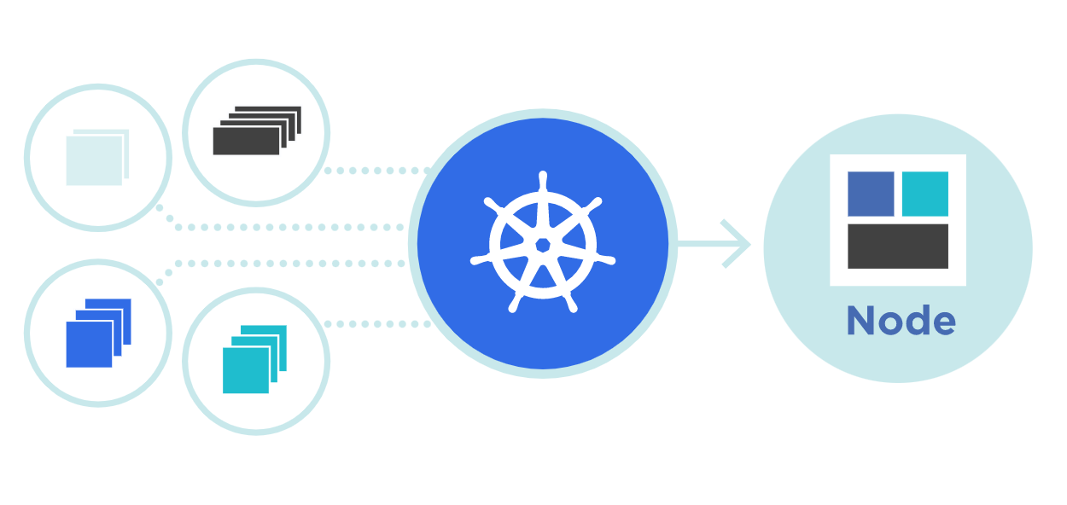



Kubernetes
Taints & Tolereation
Theory + LAB + Documents ➔ All free
WATCH NOW
Notes:
Hello everyone. My name is Anish Rana and you are watching Kubernetes web series.
In this video, I’ll try to explain, what is taints and tolerations.

Slide 2
API
Controller
Schedular
ETCD

Slide 3

What is API Server
Controller
API Server
Schedular
Etcd Database
kubectl run nginx --image=nginx
Taints/Tolerations, Node selector, Node Affinity, CPU and memory requirements

Slide 4
Taints and Tolerations
What is Taints?
What is Tolerations?
How to add Taints?
How to add Tolerations?
LAB
Notes:
Our agenda of today video are …

Slide 5
01 NOW WE WILL TALK ABOUT
What is Taints?

Slide 6
Taints is set on master nodes. It’s a key value pair, like labels and annotations.
Taints allow nodes to discard certain type of Pods.
Taints are a node property.
A node can have one or many taints associated with it.

Slide 7
02 NOW WE WILL TALK ABOUT
What is Tolerations?

Slide 8
Tolerations allow a pod to be scheduled on a node with a matching taint.
Tolerations is a Pod property and it is specified in PodSpec.
Taints and tolerations are a mechanism that allows you to ensure that pods are not placed on inappropriate nodes.

Slide 9
Node 1
Node 2
Node 3
Taint
prod=blue
Taint
prod =yellow
Taint
prod =green
POD yaml file
Toleration
prod= blue
POD yaml file
Toleration
prod = yellow
POD yaml file
Toleration
prod = green

Slide 10
03 NOW WE WILL TALK ABOUT
How to add Taints?

Slide 11
kubectl taint nodes <Node_Name> <key=green=effect>
kubectl taint nodes node1 prod=green:NoSchedule
kubectl taint nodes node1 prod=green:NoSchedule-
PreferNoSchedule
The Kubernetes scheduler will try to avoid scheduling pods that don’t have tolerations for the tainted nodes.
NoExecute
Kubernetes will evict the running pods from the nodes if the pods don’t have tolerations for the tainted nodes.
NoSchedule
This means that no pod will be able to schedule onto node1 unless it has a matching toleration.
NoExecute
PreferNoSchedule

Slide 12
kubectl taint nodes <Node_Name> <key=green=effect>
kubectl taint nodes node1 prod=green: NoExecute
kubectl taint nodes node1 prod=green: NoExecute-
PreferNoSchedule
The Kubernetes scheduler will try to avoid scheduling pods that don’t have tolerations for the tainted nodes.
NoExecute
Kubernetes will evict the running pods from the nodes if the pods don’t have tolerations for the tainted nodes.
NoSchedule
This means that no pod will be able to schedule onto node1 unless it has a matching toleration.

Slide 13
kubectl taint nodes <Node_Name> <key=green=effect>
kubectl taint nodes node1 prod=green: PreferNoSchedule
kubectl taint nodes node1 prod=green: PreferNoSchedule -
PreferNoSchedule
The Kubernetes scheduler will try to avoid scheduling pods that don’t have tolerations for the tainted nodes.
NoExecute : Kubernetes will evict the running pods from the nodes if the pods don’t have tolerations for the tainted nodes.
NoSchedule
This means that no pod will be able to schedule onto node1 unless it has a matching toleration.

Slide 14
04 NOW WE WILL TALK ABOUT
How to add Tolerations?

Slide 15
apiVersion: v1 kind: Pod metadata: name: nginx labels: env: test spec: containers: - name: nginx image: nginx tolerations: - key: "prod" operator: "Equal" effect: "NoSchedule" value: "green"
apiVersion: v1 kind: Pod metadata: name: nginx1 labels: env: test spec: containers: - name: nginx image: nginx tolerations: - key: "prod" operator: "Exists" effect: "NoSchedule"
kubectl taint nodes node1 prod=green:NoSchedule
kubectl taint nodes node1 prod=green:NoSchedule

Slide 16
apiVersion: v1
kind: Pod
metadata:
name: nginx
labels:
env: test
spec:
containers:
- name: nginx
image: nginx
tolerations:
- key: "prod"
operator: "Equal"
effect: "NoSchedule"
value: "green"
The default value for operator is Equal
In Equal operator: the key, value and effect must be equal to tainted node.
The Exists operator matches only the key and effect.
tolerations:
- key: "prod"
operator: “Exists"
effect: "NoSchedule"

Slide 17
05 NOW WE WILL TALK ABOUT
LAB

Slide 18
Taints & Toleration
Taints on Node Toleration apply on pod
Theory + Lab + Document + CKA
https://paypal.me/anishrana20011
tolerations:
- key: "prod"
operator: "Equal"
effect: "NoSchedule"
value: "green"
tolerations:
- key: "prod"
operator: “Exists"
effect: "NoSchedule"

